Slide 1
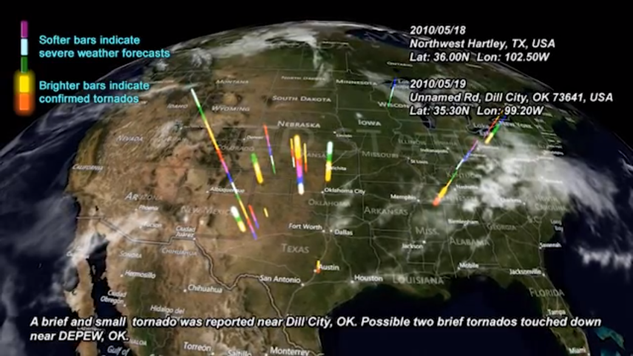

Daily Regional Weather Forecasts in Support of Vortex2
Quan Zhou, Beth Plale, Keith Danielson, Robert J. Ping, Janae Cummings, Alan Mauro
Indiana University Bloomington

Slide 2
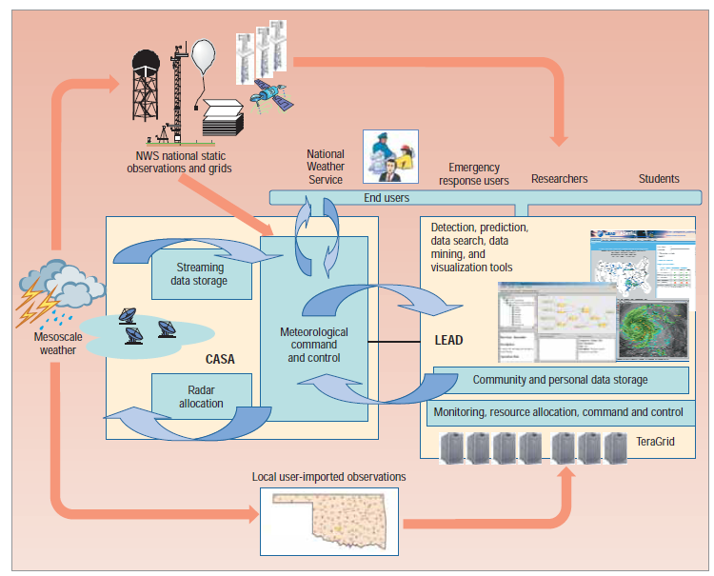
Short term Weather Forecast Generation
In support of Vortex 2 - 6-week field effort Spring 2010 to position instruments near mesoscale severe storms as they were forming
Task: execute 5 short-term regional weather forecasts each day of 6-week campaign
Region of forecast: about size of a state
Overall: 214 weather forecasts; 110,000 CPU compute hours; 215 GB dataset; 9100 2D products

Slide 3
Data Curation
Generated 5-6 short term (10-15hr) weather forecasts each day from May 01 - Jun 15 2010.
Upon completion we curated the collection: documenting discovery and use metadata for each of weather forecast
Each forecast bundled as
WRF output file
2-D visualizations of dozen or so variables
FGDC metadata for WRF output and each 2D visualization
Each day is bundled into 28GB zipped tarball

Slide 4
Data Curation – Metadata Management
Metadata generated for output products using prior metadata that was captured automatically.
FGDC used
PDF format for archived metadata is stored for purposes of long term preservation

Slide 5
Massive Dataset Mining
Data mining of massive dataset– Extract data for visualization from 28GB data tarball
Extract spatial data( geospatial bounding box) for each forecast day
Extract temporal data to make spatial data time-tagged
Extract data annotations such as organization, location name, etc..
Add visualization features such as altitude, color for each geospatial point.

Slide 6
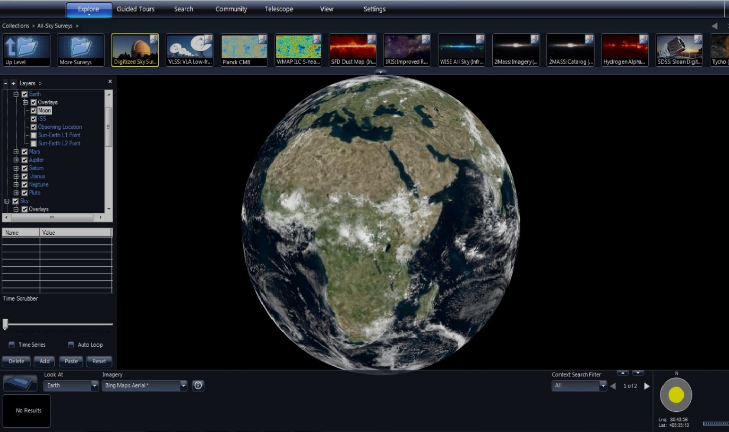
Visualization – World Wide Telescope (WWT)
WWT is visualization software environment to visualize arbitrary or abstract data sets and time series data
WWT runs under Microsoft Windows or Silverlight web client

Slide 7
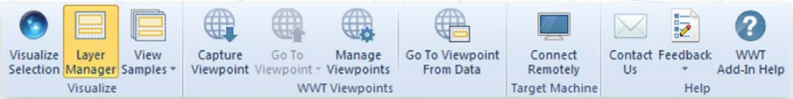
World Wide Telescope Add-in for Excel
An Add-in for Microsoft Office Excel that helps users more easily visualize location and time-based data and geometry data in WorldWide Telescope
Dynamic binding of data in Excel to the visualization in World Wide Telescope – changes to the data reflect immediately in WWT
Support earth-based visualizations

Slide 8
Visualization Creation
The visualization unfolds daily location of regional weather forecast
Bright bars reflect short term regional forecast that had National Weather Service (NWS) issued tornado warning for time in which forecast was valid
That is, Vortex2 team thought weather would be severe in region on a day, and where confirmed by NWS, bar is bright
Bright bars indicate confirmed severe weather and/or tornados.
All 173 Vortex2 records are visualized with exact coordinate information

Slide 9
Visualization Techniques
Visualization visually conveys points in space and time where weather forecast captured a confirmed tornado siting
Visualization uses times series and three-dimensional geospatial visualization techniques to display spatial distribution and temporal relation for Vortex2 data set
The video employs voice-over and text to convey importance of forecast in relation to actual weather

Slide 10
Visualization Demo
The video can be viewed at
http://d2i.indiana.edu/news/d2i-creates-vortex2-data-set-visualized-world-wide-telescope-wwt

Slide 11
Dataset Citation
Plale, Beth, Keith Brewster, Craig Mattocks, Ashish Bhangale, Eran C. Withana, Chathura Herath, Felix Terkhorn, Kavitha Chandrasekar. Weather Forecast Data from the D2I-Vortex2 project. May 1 to June 15, 2010. Bloomington, Indiana: Data to Insight Center. Jun 2012. https://scholarworks.iu.edu/dspace/handle/2022/14983

